Slide 1
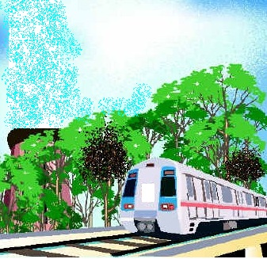

Challenges in tunneling in East West Metro Kolkata
Challenges in Tunneling in East West Metro Kolkata

Slide 2
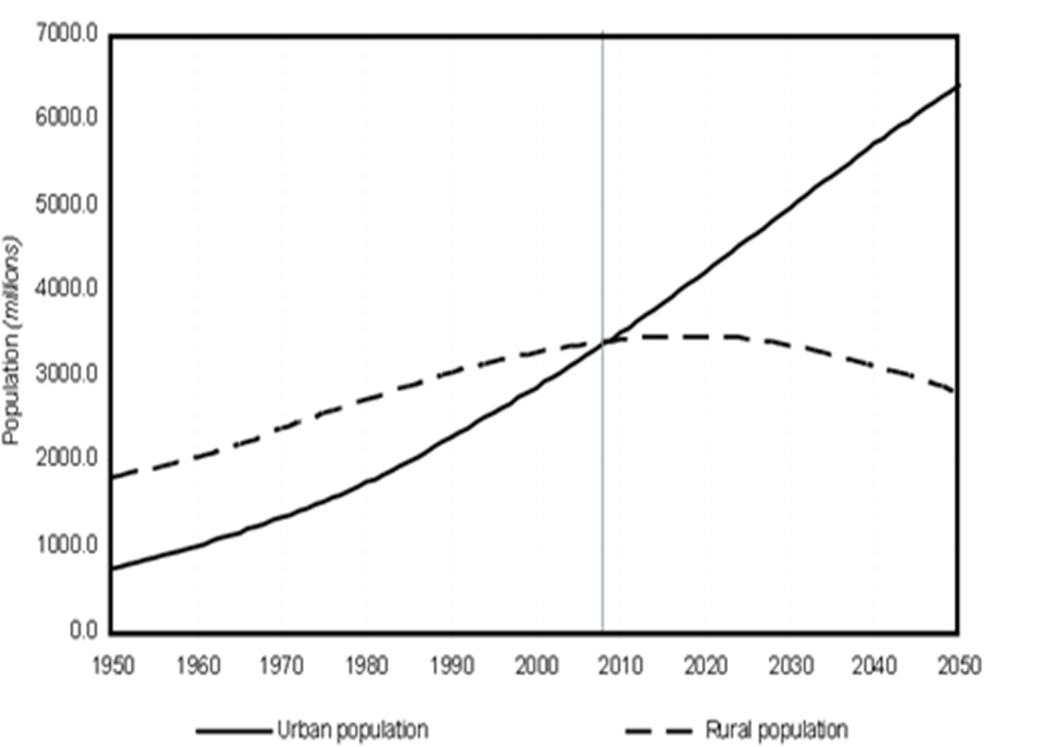
GLOBAL TRANSPORTATION SCENARIO
As per UN Habitat Report, the world is rapidly urbanizing as people from rural areas continue to move to the cities. This is a dominating phenomenon in the present day urban scenario.
Urban & Rural Population of the world 1950-2050
The urban and rural populations has become equal in 2007-08 and urban population is drastically increasing beyond 2010.
Challenges in Tunneling in East West Metro Kolkata

Slide 3
TRANSPORTATION SCENARIO IN KOLKATA
Increase in Transportation Demand in KMA
Availability of Road Network in KMA
Criteria | 2001 | 2025 | % increase
Population | 14.7Million | 21.0 Million | 46
Motorized Vehicle | 10Lakh | 30Lakh | 300
Daily transit Passenger | 187Lakh | 322Lakh | 72
Goods Vehicle | 41000/day | 71000/day | 73
Goods carried per year | 980 Lakh-Ton/day | 1700 Lakh-Ton/day | 73
Daily commuters in KMA | 12Lakh | 20Lakh | 67
Total fast trans-river traffic | 1.43 Lakh/Day | 3.12Lakh /Day | 118
 | 1981 | 1991 | Remarks
Transportation | 6.2% | 5.4% | As per URDPFI Guidelines 15%-18%
Kolkata has minimum length of roadwork [1404 KM] amongst Metro Cities whereas Delhi has highest of 25,948 KM
Challenges in Tunneling in East West Metro Kolkata

Slide 4
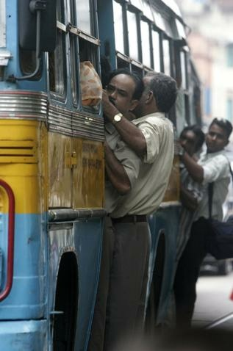
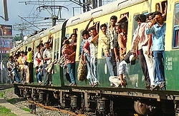
TRANSPORTATION SCENARIO IN KOLKATA
Traffic Congestion
City Roads suffer from :
Inadequate width
Unscientific geometrics
Close intersections
Same right of way for all types of vehicles
As per Comprehensive Mobility Plan for KMA as prepared by KMDA in 2008 [ IDFC &SGI]:
35.8% roads are less than 4 lane wide
89% roads have undivided carriageway
Road side parking covers substantial carriageway volume
65% arterial roads in KMA Area is having volume/capacity ratio more than 0.8 and level of service D or below
Challenges in Tunneling in East West Metro Kolkata

Slide 5
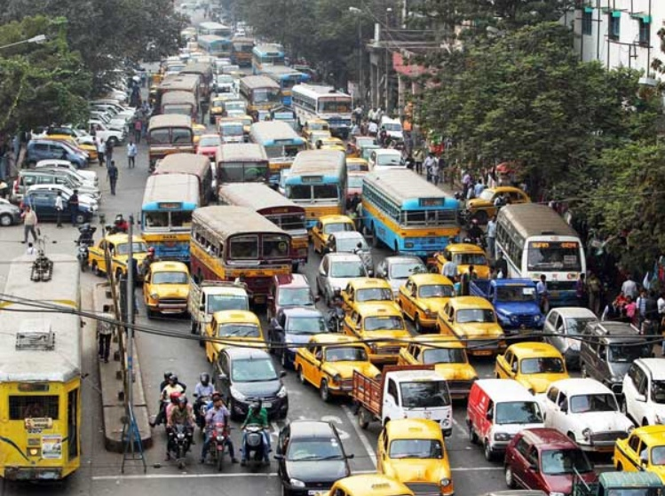
TRANSPORTATION SCENARIO IN KOLKATA
Traffic Congestion
In 72% of roads, travel speed less
than 20 KMPH
Avg growth of vehicles 7% pa
Avg growth of two wheelers 7.9% pa
& auto-rickshaw 14% which are
alarming figures.
Air Pollution Scenario
SPM Level 150-250 [WHO standard max 90]
RSPM Level 70-120 [WHO standard max 60]
Accident Scenario
As per Kolkata Traffic Police, 2000-3000 Accidents are reported each year with 400-500 casualties.
65% of victims are pedestrians & non-motorized vehicles
Challenges in Tunneling in East West Metro Kolkata

Slide 6
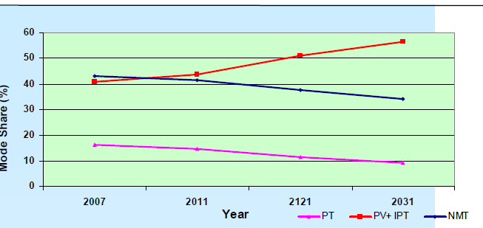
TRANSPORTATION SCENARIO IN KOLKATA
Mode Share (%)
Public Transport Share is reducing
Year
Growth/Reduction of Bus Transport in Indian Cities in last decade
Mumbai | Delhi | Chennai | Kolkata | Bengaluru
0.80% decrease | 7.7% decrease | 1.7% decrease | 3.5% decrease | 9.4% increase
Challenges in Tunneling in East West Metro Kolkata

Slide 7
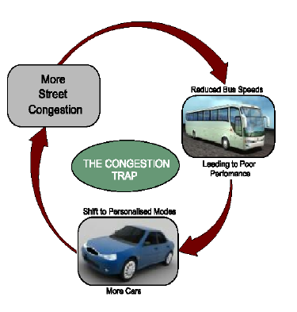
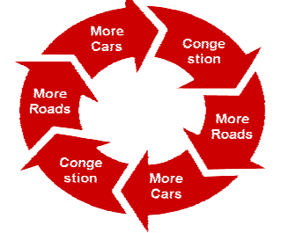
TRANSPORTATION SCENARIO IN KOLKATA
“Adding highway lanes to deal with traffic congestion is like loosening your belt to cure obesity.”
Challenges in Tunneling in East West Metro Kolkata

Slide 8

TRANSPORTATION SOLUTION
Bangkok Declaration
Strategies to Avoid unnecessary travel and reduce trip distance
Strategies to Shift towards more sustainable modes
Strategies to Improve transport practices and technologies
Cross –Cutting technologies [ People First approach]
5th Regional Environmentally Sustainable Transport Forum in Asia Forum, 23-25 August 2010
Challenges in Tunneling in East West Metro Kolkata

Slide 9
Benefits of MRTS/METRO
Reduces 1/5th energy per passenger Km.
Causes less noise, less air pollution & eco-friendly
Occupies no road space in case of underground and 2.6m width in case of elevated
Reduces travel time
Reliable and safe journey
Offers point to point service
Initial investment in Metro Railway is high but it can provide long term economic, social and environment benefits.
Metro becomes attractive to commuters as well as economically viable to operators if option to travel from any point of city to any point of city is provided through expansion of network or through intermodal connections
METRO IN KOLKATA
Challenges in Tunneling in East West Metro Kolkata

Slide 10
NEED FOR METRO
METRO IN KOLKATA
Need for MRTS reflected in Mobility Master Plan
Mobility Master plan prepared in 2004 by KMDA with target year 2025 & Comprehensive Mobility Planning, 2008 [IDFC et al]
Recommended
Kolkata being a old city grown up through centuries without comprehensive holistic planning has ended up with narrow road ROW, thus road volume by target year 2025 could be 8% only.
Priority on eco-friendly Non Road based Mass Rapid Transit system was recommended
High density compact development around the transportation nodes was suggested.
Need for MRTS system in Kolkata was even envisaged long ago in 1960’s considering the ever growing congestion level.
Challenges in Tunneling in East West Metro Kolkata

Slide 11
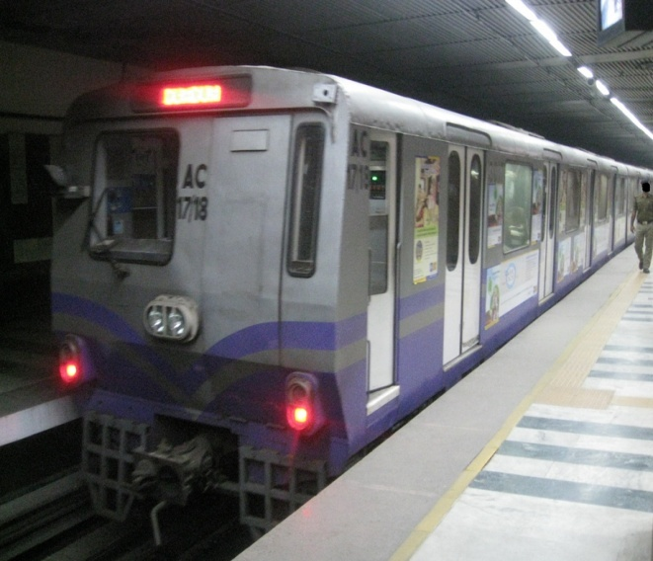
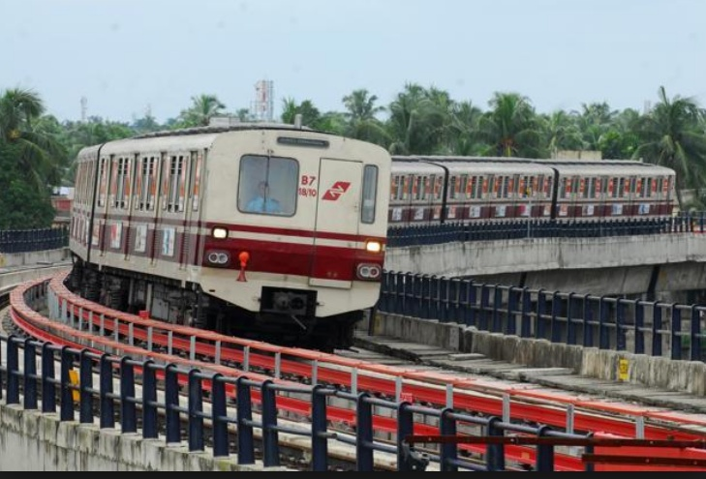
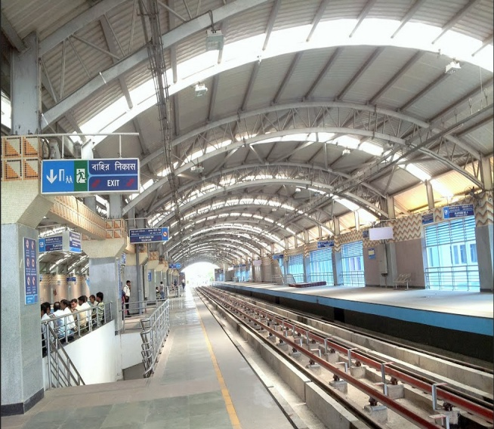
NEED FOR METRO
METRO IN KOLKATA
The work of the 1st Metro in the country was started in Kolkata in 1972
It was the fifth such system in entire Asia.
Commercial services started in 1984 - popularly known as North-South Line
The existing line is initially commissioned for 16.45 Km length in Phase-I which is further extended for another 10.776 Km in 2009-13 and total operation length is 27.226 Kms
Performing successfully for over three decade under Operation and maintenance of Indian Railways.
Challenges in Tunneling in East West Metro Kolkata

Slide 12
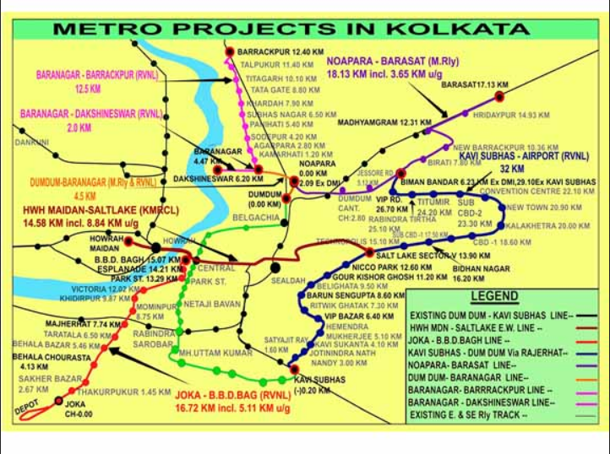
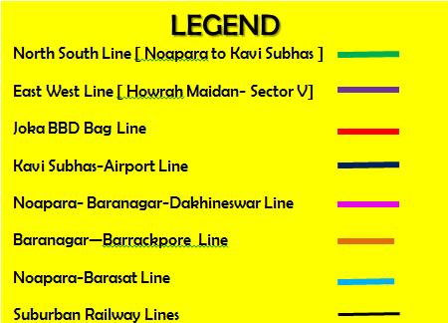
FUTURE METRO NETWORK IN KOLKATA
Noapara-
Barasat Line
Baranagar
Barrackpore
line
Kavi Subhas-
Airport
line
Noapara-
Dakhineswar
line
East-West
Line
Joka-Esplanade
Line
Existing North South Line

Slide 13
THE REVISED ALIGNMENT OF EAST-WEST METRO KOLKATA
Elevated Corridor 5.8 kms
Underground Corridor 10.8 kms
Total 16.6 kms
Central Park Station
Phase-II
7.2 kms
Target : Aug,19
Phase-I
9.4 kms
Target: Jun,18
Underground
7.2 kms
Karunamoyee Station
City Center Station
U/G Station : 4 nos.-
Work in 2 no. station in progress
Underground
3.6 kms-Twin Tunnels completed
H O O G H L Y
Sector-V
Bengal Chemical Station
Tunnel under River Hooghly
Salt Lake Stadium Station
Howrah Station
Phoolbagan Station
RAMP Section
Howrah Maidan
Elevated Viaduct
5.8 kms – Completed except 365M
Mahakaran Station
Sealdah Station
H O O G H L Y
Esplanade
Elevated Station: 6 no
Structural Work for all stations completed.
Roofing in Progress
LEGEND
U/G Station: 2 no - Work in Progress
Completed
In Progress
Underground
Elevated
Re-alignment

Slide 14
BENEFIT OF KOLKATA EAST-WEST METRO
Major Railway terminal at Howrah
River transport jetty at Howrah
Major connectivity
Central Business District
Existing N-S Metro
Major Railway terminal at Sealdah
IT Hub at Salt Lake Sector-V
Savings in travel time by 45 min
Savings in VOC- fuel & decongestion
Project Benefits
Eco-friendly
Commuter Safety & comfort
Challenges in Tunneling in East West Metro Kolkata

Slide 15
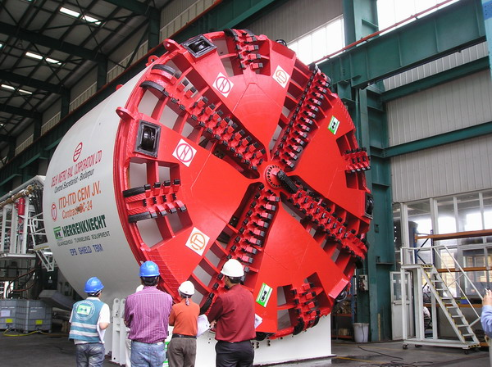
1st
1st Transportation Tunneling using EPBM TBM in Eastern India.
1st Transportation Tunnel under any mighty river in India
1st MRTS connecting two major Railway terminals at Howrah & Sealdah.
Challenges in Tunneling in East West Metro Kolkata

Slide 16
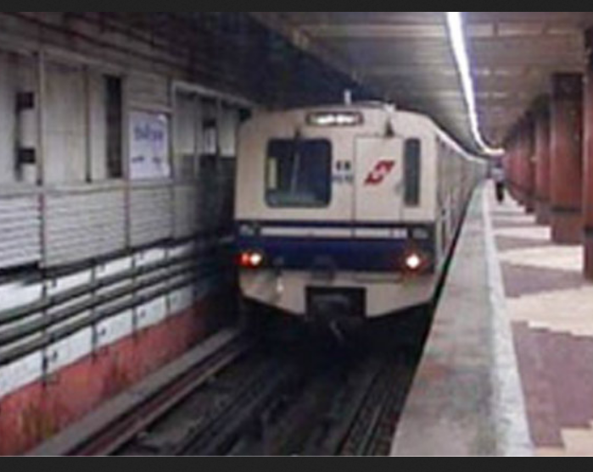
UNDERGROUND TUNNELING
North-South Metro was constructed in 1980’s with Bottom-Up Cut & Cover method in most of its length but it is unimaginable in present day traffic scenario.
The underground part of the present E-W Metro is therefore considered as below:
Tunneling using Earth Pressure Balance Tunnel Boring Machine along the alignment.
Underground stations to be constructed by Top-Down Cut & Cover Method with Diaphragm wall.
Challenges in Tunneling in East West Metro Kolkata

Slide 17
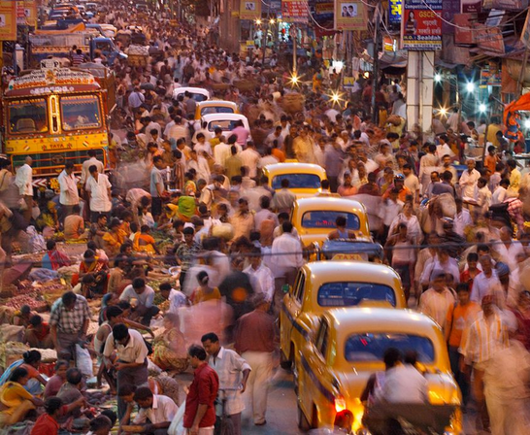
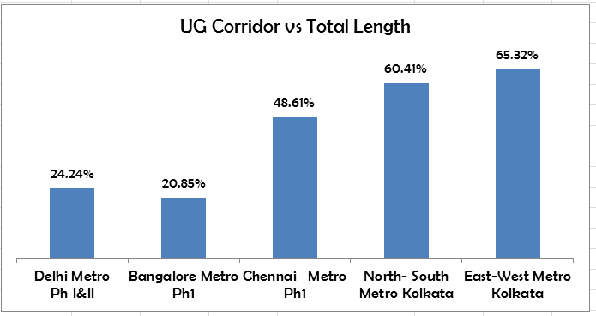
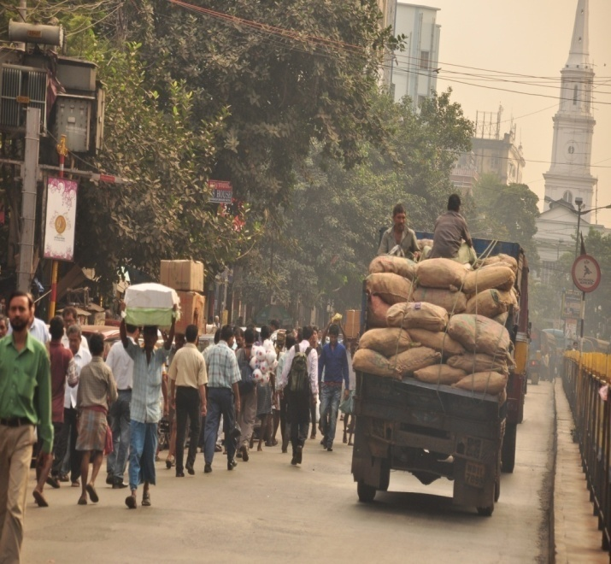
UNDERGROUND TUNNELING
The alignment of East-West Metro will pass through the most congested part of Kolkata with narrow streets and century old buildings around.
Majority of the alignment is therefore planned to be underground [ 65%]
Challenges in Tunneling in East West Metro Kolkata

Slide 18
UNDERGROUND TUNNELING
1) Construction in busy city
Adoption of standard gauge allowed sharp curves to minimize land acquisition and restrict alignment mostly in Road ROW.
Effective coordination with Civic Authorities for traffic blockade & utility diversion
2) Soft Clay Sub-soil
Choice of proper TBM
Effective design of Tunnel liners
Efficient control of tunneling parameters & alignment
Management of Distress to Buildings
Meticulous Building Condition Survey
Proper Structural assessment & prediction of settlement.
Pre-tunneling & post-tunneling rectification measures
Proper monitoring & quick response to situation.
Challenges being faced
Challenges in Tunneling in East West Metro Kolkata

Slide 19
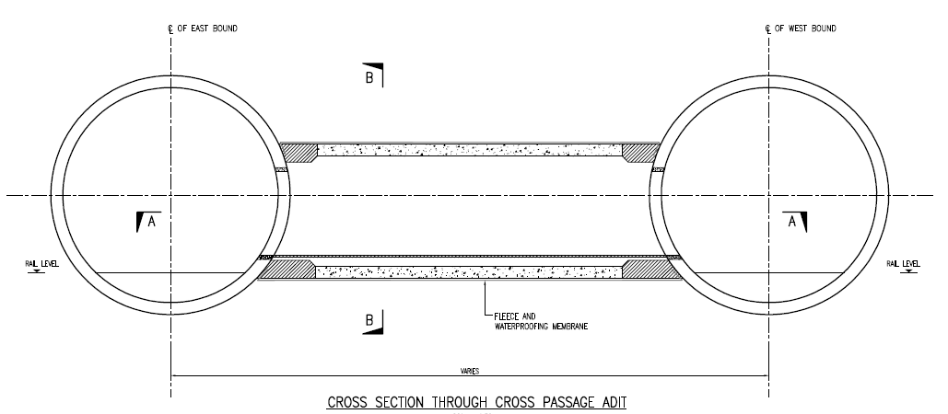
REQUIREMENT OF CROSS PASSAGES INSIDE THE TUNNEL
@250M INTERVAL BY NATM
UG-2: 5800 mm
UG-1: 5550 mm
2800 mm
Challenges in Tunneling in East West Metro Kolkata

Slide 20
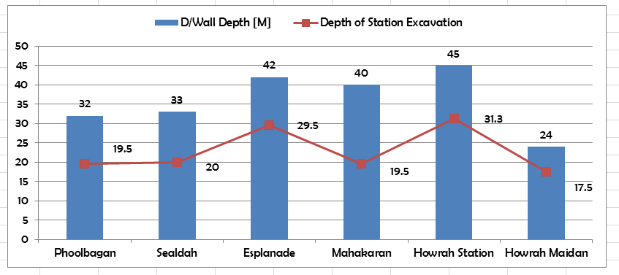
UNDERGROUND STATIONS
Challenges in Tunneling in East West Metro Kolkata

Slide 21
Tunnel Geology in Kolkata
Challenges in Tunneling in East West Metro Kolkata

Slide 22
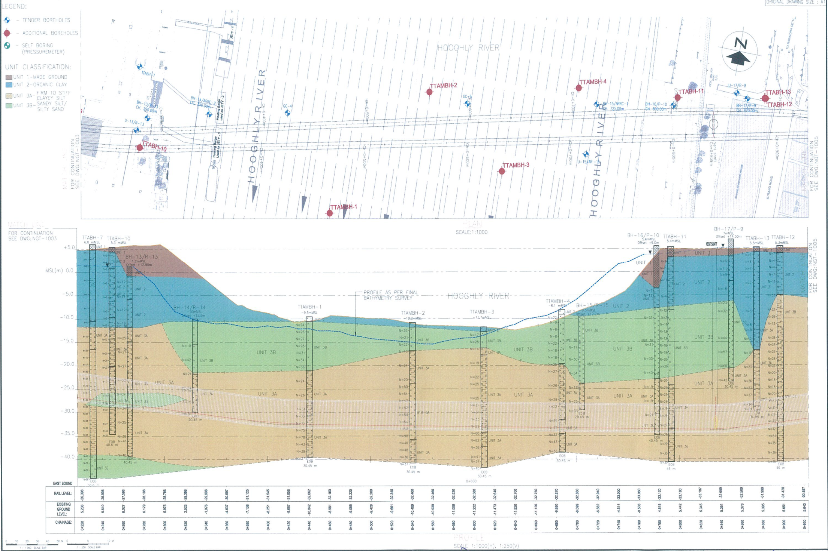
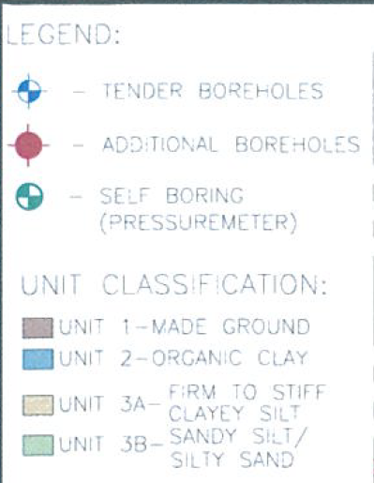
KOLKATA METRO TUNNEL GEOLOGY-Ph II
Challenges in Tunneling in East West Metro Kolkata

Slide 23
Selection of Tunnel Boring Machine
Challenges in Tunneling in East West Metro Kolkata

Slide 24
CHOICE OF PROPER TUNNEL BORING MACHINE
In Soft ground selection of Tunnel Boring Machine depends on :
i) Grain Size distribution of soil
^{ii) Angle of Friction}
^{iii) Cohesion}
^{iv) Deposit thickness}
Challenges in Tunneling in East West Metro Kolkata

Slide 25
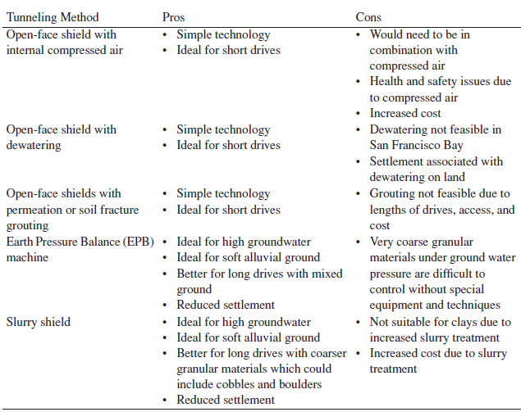
CHOICE OF PROPER TUNNEL BORING MACHINE
Challenges in Tunneling in East West Metro Kolkata

Slide 26
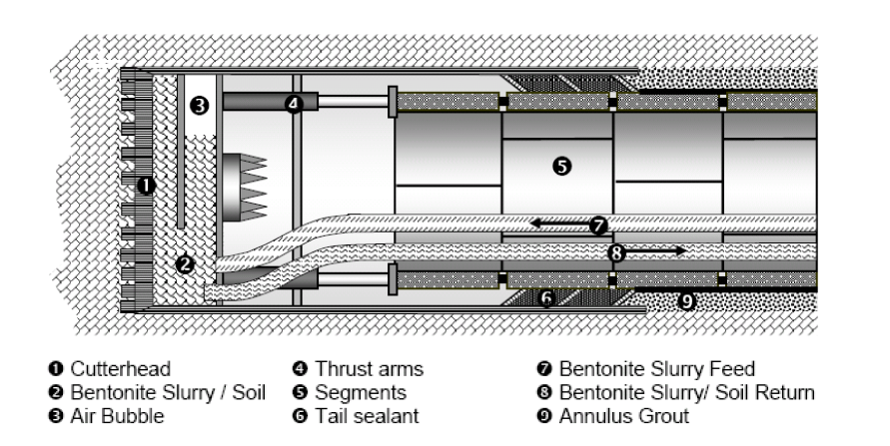
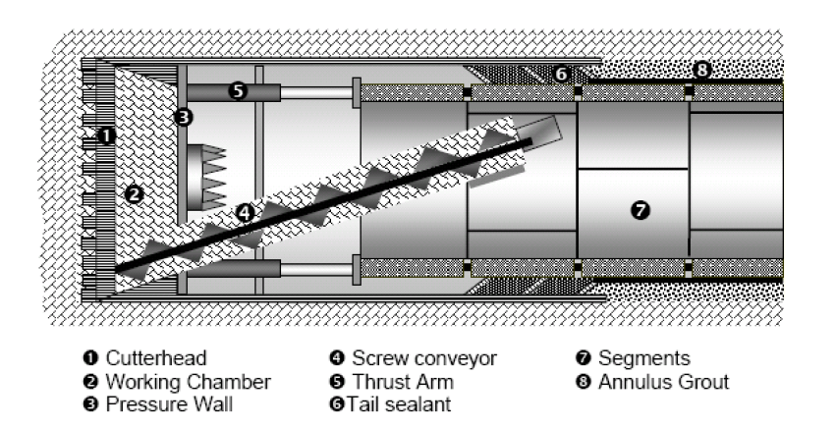
CHOICE OF PROPER TUNNEL BORING MACHINE
WTC World Tunnel Congress in Bangkok, Thailand with a
.
Slurry Pressure Balance
Earth Pressure Balance
Challenges in Tunneling in East West Metro Kolkata

Slide 27
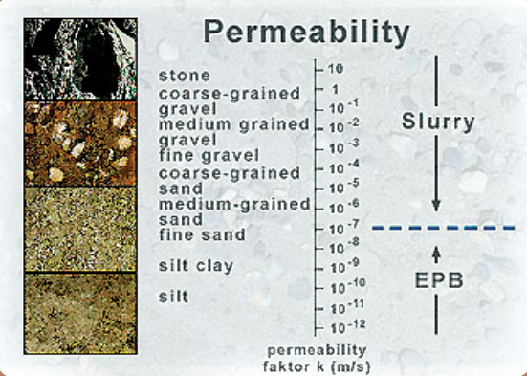
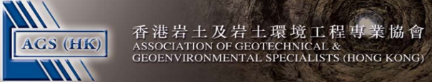
CHOICE OF PROPER TUNNEL BORING MACHINE
Challenges in Tunneling in East West Metro Kolkata

Slide 28
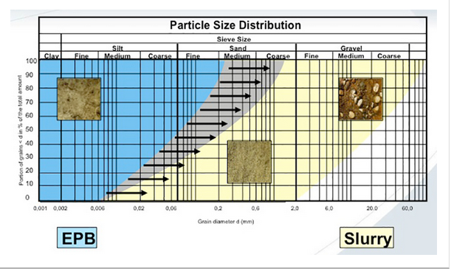
CHOICE OF PROPER TUNNEL BORING MACHINE
WTC World Tunnel Congress in Bangkok, Thailand with a
WTC World Tunnel Congress in Bangkok, Thailand
“The first large diameter slurry TBM's in India - Selection of the tunnelling system for the Bangalore Metro”
by R. L. Moncrieff.
Challenges in Tunneling in East West Metro Kolkata

Slide 29
Operatives of TBM & Design of Tunnel Liners
Challenges in Tunneling in East West Metro Kolkata

Slide 30
TBM SCHEMATIC
Body
Cutter Wheel
Gantry Backup Unit
P
Grouting
Screw
Main Gear Oil
Jack
Control
Sludge
Conveyor Oil
oil
P
Monitor
Control
6.35
P
P
P
Panel
Panel
MDB
Tool
75.0 m
8.0 m
EPB.TMB
(Earth Pressure Balance Tunnel Boring Machine)
Challenges in Tunneling in East West Metro Kolkata

Slide 31
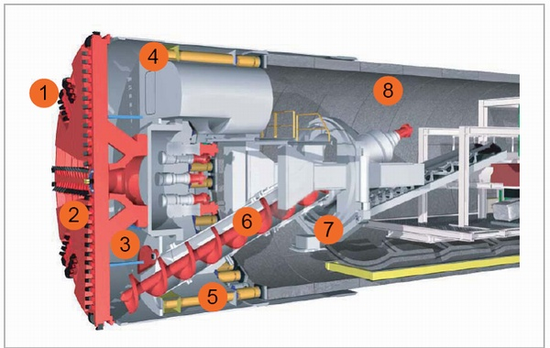
TBM SCHEMATIC
Components of TBM
Cutter Disk
Hydraulic Oil Tank
Tunnel Segments
2.5rpm
9
Planet Gears
Conveyer
Screw Feeder
Teeth
Segment Erector
Shoving Hydraulic Jack
3
Mixing Chamber
Challenges in Tunneling in East West Metro Kolkata

Slide 32
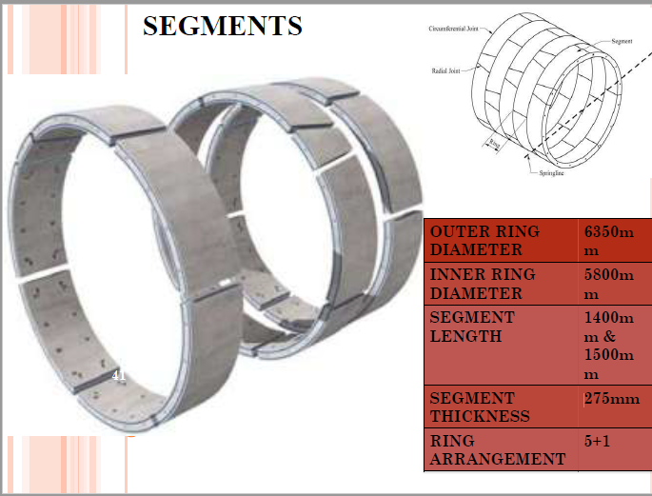
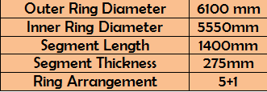
TYPICAL ARRANGEMENT OF STANDARD SEGMENTS & KEY
TBM SCHEMATIC
Challenges in Tunneling in East West Metro Kolkata

Slide 33
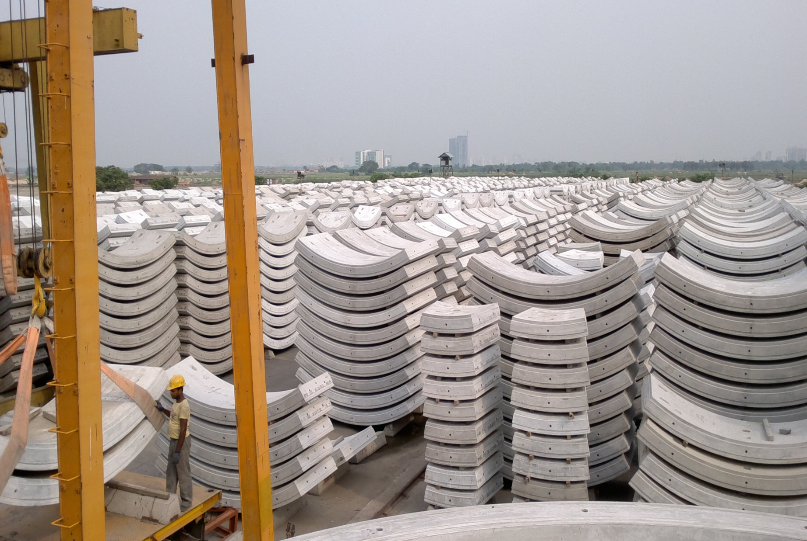
Segments stacked at Casting yard
Tunneling Works
31

Slide 34
TBM MOVEMENT SCHEMATIC
progression of TBM and Segment
1.2-1.5
Speed 8 mm /min
Rotation 2.5 rpm /min
Segment
Grouting Material
Challenges in Tunneling in East West Metro Kolkata

Slide 35
KEY TO SUCCESS
Successful TBM Operation Depends
Maintenance of Proper Face Pressure
Alignment Control through proper ring building
Use of proper conditioning agent for declogging of excavated muck
Proper Grout Pressure & Volume
Challenges in Tunneling in East West Metro Kolkata

Slide 36
UNDERGROUND TUNNELING IN KOLKATA
The following Technical factors are considered critical for tunneling work
Factors
Solutions/Monitoring
Soft Clay subsoil | Proper Selection of TBM | Effective design of tunnel lining | Proper operation of TBM & Face Pressure | Alignment control of TBM
Less overburden at places | Effective design of tunnel lining | Proper operation of TBM | Alignment control of TBM | Heaving Check
High water table & water proofing | Use of low permeability concrete | Proper waterproofing & grouting | Floatation Check
Sharp Curves | Proper Selection of TBM | Use of proper taper segments for right & left leads | Proper operation of TBM and correct key positioning | Alignment control of TBM
Close proximity of tunnels | Effective design of tunnel lining | Proper monitoring | precautionary measures
Existence of old fragile buildings in tunnel vicinity | Proper Ground settlement and building condition analysis | Proper Monitoring & control of settlement | Preventive Measures
Deep Tunnel under Hooghly | Proper Selection of TBM | Effective design of tunnel lining | Proper operation of TBM & Face Pressure | Alignment control of TBM | Operational Safety
Challenges in Tunneling in East West Metro Kolkata

Slide 37
Final Structural Design Out put for Tunnel Lining in Phase-II
Tunnel internal diameter 5.55m
Thickness of RCC Precast segmental lining 275 mm
Universal Length of tunnel segment along tunnel axis :
1.4m with taper width from 1375mm to 1425mm.
No of segment in each ring- Standard Segment :5+ key segment : 1
No of Straight bolt- Standard Segment : 10 , Key Segment : 6
Grade of concrete M50
Rebar = Light : 140 Kg/m3
Medium :154 Kg/m3
Heavy : 200 Kg/m3
Challenges in Tunneling in East West Metro Kolkata

Slide 38
Managing Ground Settlement & Building Distress
Challenges in Tunneling in East West Metro Kolkata

Slide 39
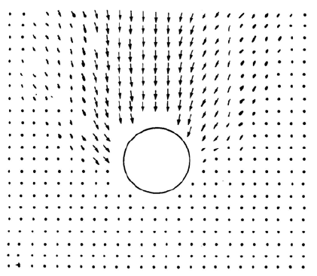
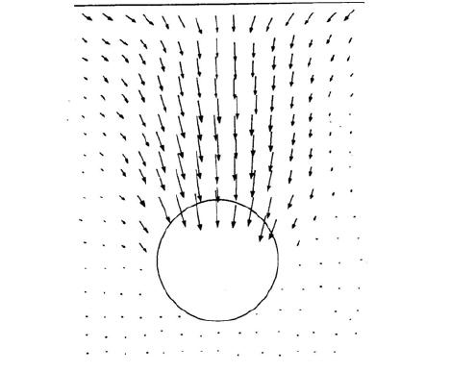
DESIGN OF TUNNEL
MANAGEMENT OF SETTLEMENT
Soil Deformation around Tunnel in Cohesive Soil
[ Kiruma & Mair, 1981]
Soil Deformation around Tunnel in Cohesion less Soil
[ Potts, 1976]
Challenges in Tunneling in East West Metro Kolkata

Slide 40
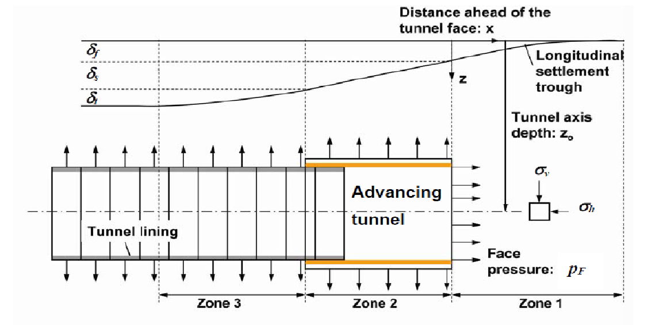
MANAGEMENT OF SETTLEMENT
Volume Loss Components and related parameters during
Tunnel Boring Machine Operation
Challenges in Tunneling in East West Metro Kolkata

Slide 41
MANAGEMENT OF SETTLEMENT
Components of Volume Loss due to Tunneling
Face Loss - Due to inward flow of ground into the shield from zone of influence ahead and side of shield [Zone 1]. To Control volume loss at the face, Tunnel advancement parameters are required to be controlled.
Shield Loss –To advance the shield, it is required to bore a slight oversize hole; after passage of the shield, there will be an annular void around the tunnel boring machine in Zone 2 and surrounding soil will try to move radially inward to fill this void and create a loss of ground.
Challenges in Tunneling in East West Metro Kolkata

Slide 42
MANAGEMENT OF SETTLEMENT
Components of Volume Loss due to Tunneling
Tail Loss -Extrados diameter of Tunnel liner being smaller than diameter of tunnel boring shield, there will be an annular space when, the erected tunnel liners exit from tail of the TBM in Zone3. This annular space is filled up with grout material ejected from Tail , There is a possibility of soil to displace radially inward creating a volume loss before the grout hardens in Zone 3
Radial Loss
After grouting – Long term radial displacement of soil towards tunnel after grouting due to deformation of tunnel liner due to transfer of overburden pressure to new boundary.
Challenges in Tunneling in East West Metro Kolkata

Slide 43
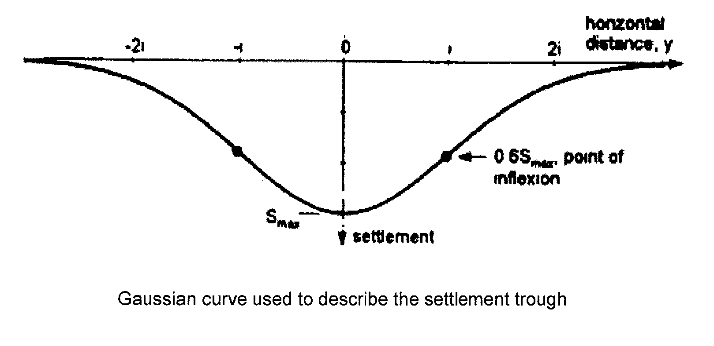
TUNNELING UNDER CLAYEY SUB-SOIL
Management of Ground Settlement & Distress in Buildings-
Ground Movement due to bored tunneling
X
y
S
Challenges in Tunneling in East West Metro Kolkata

Slide 44
TUNNELING UNDER CLAYEY SUB-SOIL
Management of Ground Settlement & Distress in Buildings-
Ground Movement due to bored tunneling…..contd
where
S_{max =} Maximum Settlement on the tunnel Center Line.
y = Horizontal distance from Center line of tunnel
S = Settlement at distance ‘y’ from Center line of tunnel
i= Horizontal distance from tunnel center line to the point of inflexion on settlement curve.
Where i = KZ₀
K is a parameter which varies between 0.5 for clay to 0.25 for sand.
Z₀ is the depth to the center of the tunnel.
D is the excavated diameter of the tunnel
V is the volume loss per unit length of tunnel progress expressed in percentage of excavated tunnel face area which is considered 1% to 1.5%
[As per Peck(1969) & Orilley and New (1992) for cases where no major ground loss and consolidation settlement is considered]
S_{max} = 0.0031 x VD²/ i
S= S_{max .} e
(-y²/2i² )
Challenges in Tunneling in East West Metro Kolkata

Slide 45
TUNNELING UNDER CLAYEY SUB-SOIL
Management of Ground Settlement & Distress in Buildings-
Challenges in Tunneling in East West Metro Kolkata

Slide 46
TUNNELING UNDER CLAYEY SUB-SOIL
Management of Ground Settlement & Distress in Buildings-
Real Time Management of Ground Settlement
Building Condition Survey
Geo-Technical Investigation
Ground Movement & Structural Assessment Report
Finalisation of Tunneling Parameters
Planning for Pre-Tunneling Mitigation Measures
Reassessment of Parameters
Monitoring during Tunneling
Post Tunneling Restoration of Damages
Challenges in Tunneling in East West Metro Kolkata

Slide 47
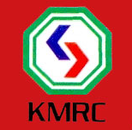
Assessment of Building damage
Three categories of building damages can be considered that affect:
visual appearance or aesthetics,
2. Serviceability or function and
Stability.
As foundation movements increase, damage to a building will progress successively from (i) through (ii) to (iii). It is only a short step from these three broad categories to the detailed classification given in next Table .
Challenges in Tunneling in East West Metro Kolkata

Slide 48
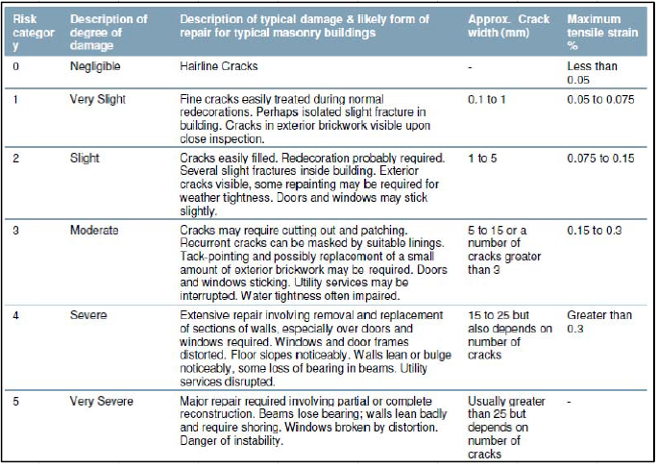
TUNNELING UNDER CLAYEY SUB-SOIL
Management of Ground Settlement & Distress in Buildings
Building Damage classification [ Burland et al 1977 & Boscardin and Cording,1989
Challenges in Tunneling in Eat West Metro Kolkata

Slide 49
Limiting Tensile Strain
Challenges in Tunneling in East West Metro Kolkata

Slide 50
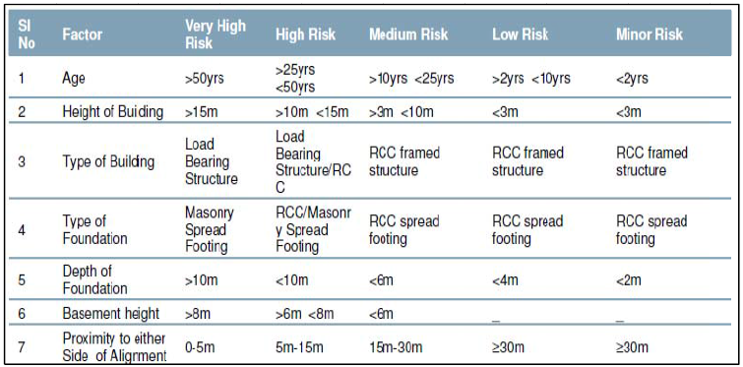
TUNNELING UNDER CLAYEY SUB-SOIL
Management of Ground Settlement & Distress in Buildings
Factors considered for risk categorization of building
A building condition survey is done within the influence zone (25m to 40m from the Centre Line of Tunnel on either side and UG Stations ) and vulnerable buildings are identified .
Challenges in Tunneling in East West Metro Kolkata

Slide 51
TUNNELING UNDER CLAYEY SUB-SOIL
Management of Ground Settlement & Distress in Buildings
Analysis Before commencement of tunneling
Existing Differential Settlement
[From Building condition survey]
Calculated Differential Settlement due to tunneling
Total differential Settlement
[existing+
anticipated]
Angular Distortion of building
Final Distortion
Existing tensile strain
[From Building condition survey]
Calculated tensile strain due to tunneling
Total tensile strain
[existing+
anticipated]
Tensile Strain in building
Final Distortion [existing+anticipated]
Protective Measures to be taken
CHECK
Total tensile strain [existing+ anticipated]
Monitoring during tunneling
Monitoring of Diff. Settlement
Alert
Angular distortion
1 in 1000
Action
Angular distortion
1 in 625
Alarm
Angular distortion
1 in 500
Work Suspension & reassessment

Slide 52
TUNNELING UNDER CLAYEY SUB-SOIL
Management of Ground Settlement & Distress in Buildings-
Real Time Management of Ground Settlement
Based on the ground settlement & building distortion analysis, the values of Alert, Action & Alarm [AAA] are assigned.
In field, the monitoring is done against those parameters using :
Tilt Meter Angle
Horizontal & Vertical deflection values for Optical Targets
D-Wall Inclinometer deflection values
Active pore pressure on D-Wall by Piezometer
Stand pipe Water Table
Building Settlement Marker.
Surface Settlement Marker.
Challenges in Tunneling East West Metro Kolkata

Slide 53
Tunnelling below Colvin Court
The West Bound Tunnel Boring Machine had to pass 11 m below Colvin Court Building which is more than 91 years old 4 storied brick masonary building situated in Howrah Maidan Church Road area. Colvin court is being used for quarters of Railway Officers.
-Issues
prediction of Ground Movement and Structure Impact Assessment for Colvin Court building due to Tunnel induced ground movements
comparison of actual ground movements.
various mitigation measures taken to ensure safety during tunneling operation.
Challenges in Tunneling in East West Metro Kolkata

Slide 54
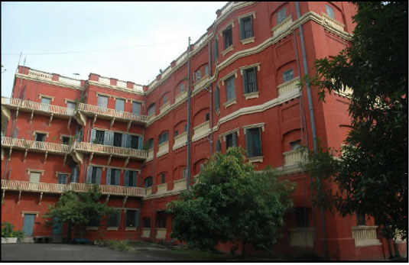
Tunnelling below Colvin Court
Challenges in Tunneling in Eat West Metro Kolkata

Slide 55
TUNNELING BELOW COLVIN COURT
Challenges in Tunneling in Eat West Metro Kolkata

Slide 56
Methodology and Protective Measures adopted
 | Building condition survey and assessment of health of the structure – Visual inspection to assess the condition of the building.
 | Detailed high quality digital photographic documentation showing all major distress of the building.
 | Distress mapping of existing building including documentation of distress like cracks , delamination, geometric deformation of structural component and out of plumb etc.
 | Inspection and assessment of all components of building like structural system including floor , exterior walls , windows, frames , exterior doors and frames, stairs , Balconies, roof coverings, roof drainage etc.
Challenges in Tunneling in East West Metro Kolkata

Slide 57
Methodology and Protective Measures adopted
 | Present condition of the Colvin Court Building
 | Building condition survey of the Colvin court was conducted earlier in the year 2010.
 | New Building condition survey was conducted in 2016 to assess the present condition of the Colvin court building.
 | A comparison of the building condition was done to study the amount of deterioration in past 5 years.
Challenges in Tunneling in East West Metro Kolkata

Slide 58
Methodology and Protective Measures adopted
 | Present condition of the Colvin Court Building
 | It is evident from the structure monitoring reports that the buildings have undergone further settlement even if no construction related activities were taken up during last 5 years.
 | The settlements were predominantly attributed to primary/secondary consolidation of soil, seasonal variation of water table and extraction of ground water by private bore well owners as well as by various authorities.
 | Colvin Court have undergone further settlement during this period ( 2010 -16) of time resulting into increased strain into the building.
Challenges in Tunneling in East West Metro Kolkata

Slide 59
Methodology and Protective Measures adopted
 | Present condition of the Colvin Court Building
 | Also this building has undergone 3 earthquakes recently. Considering the age and condition of building the impact of earthquake cannot be ignored on the structure and there is likelihood that the impact of quake must have further deteriorated the condition of building.
 | Considering the above points and latest building condition survey report, it was concluded that Colvin Court building has undergone further deterioration due to combined effect of multiple reasons enumerated above.
Challenges in Tunneling in East West Metro Kolkata

Slide 60
Summary of Risk Categories of Analyzed Buildings
for Anticipated Surface Settlements
Building | Section analyzed | Tensile Strains (%) | Category
Colvin Court | Section - 1 | 0.093 ** | Slight
 | Section - 2 | 0.103 | Slight*
 | Section - 3 | 0.096 | Slight
* approximately 0.1% ** As this particular section contains the corner of the building and also skewed to the perpendicular direction of tunnel, therefore it is considered under slight category
Challenges in Tunneling in East West Metro Kolkata

Slide 61
Suggestions after Assessment
Considering current building condition and anticipated surface settlement of 25mm for volume loss of 1.5% , impact on Colvin Court building can be categorized under “Slight Category”.
Although the estimated additional tensile strains for Colvin Court & Railway Staff Quarter buildings are in order of 0.1%, but present condition of building is not good. Considering the present condition of the building higher tensile strains may increase risk to building damage. Considering that surface settlement may increase, additional mitigation measures were adopted to avoid heavy damage in both the buildings.
Considering condition, age of buildings and volume loss of about 1.5 %, following precautionary measures were recommended to ensure safety of buildings:
Challenges in Tunneling in East West Metro Kolkata

Slide 62
Methodology and Protective Measures adopted
1.0 | Pre-emptive measures such as repairing of cracks before start of tunneling under the building
2.0 | Widening of foundation of affected portion
3.0 | Evacuation of building prior to tunnelling
4.0 | Slabs, arches, columns etc. were supported using staging (such as cup lock system, use of tie rods, temporary or permanent propping, wrapping of columns etc.) upto 25 metres on either sides of tunnel.
Challenges in Tunneling in East West Metro Kolkata

Slide 63
Methodology and Protective Measures adopted
5.0 | Vertical propping at critical load transfer locations as an alternative load path. These supports were provided with jacking facility to ensure a positive support at all times. The protective measures were implemented before the TBM cutter head reached within 25m distance from the building.
6.0 | Grouting the first layer below the foundation in order to make it stiffer.
7.0 | Tunnel boring to be done as fast as possible below these critical areas and measures taken to reduce the ground volume loss.
8.0 | The operation of TBM shouldn’t be stopped while the TBM is below these critical buildings.
Challenges in Tunneling in East West Metro Kolkata

Slide 64
Methodology and Protective Measures adopted
9.0 | Face pressure for the TBM boring were calibrated in a very interactive way to minimize the ground settlements.
10 | Application and maintenance of proper face pressure during tunneling operation.
11 | Injecting bentonite slurry through the shield to minimize ground relaxation
12 | Reducing the time between ring excavation and ring building (settlements in clay are basically a time dependent phenomenon)
Challenges in Tunneling in East West Metro Kolkata

Slide 65
Methodology and Protective Measures adopted
13 | Reducing the time between ring excavation and ring building (settlements in clay are basically a time dependent phenomenon)
14 | Monitoring of differential settlement during tunneling
15 | Post tunneling repairs to the building
Challenges in Tunneling in East West Metro Kolkata

Slide 66
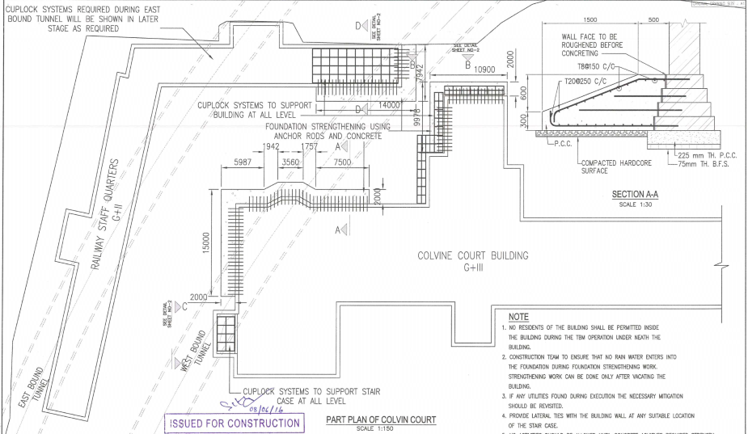
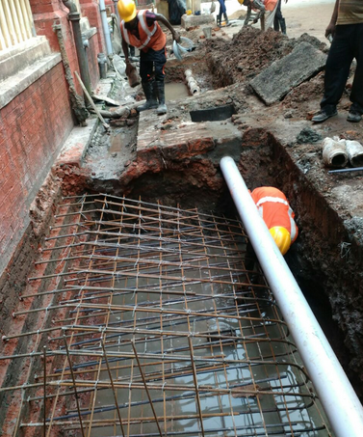
TUNNELING BELOW COLVIN COURT
Widening of Foundation of affected portion
The footing of the building in north east corner within the influence zone of the tunnel was widened by following methodology :
Excavation to side of the foundation in stretches upto 1.00m from GL.
Anchor fastening 16mm dia bars in existing foundation @ 200mm C/C horizontally and vertically.
Roughening the side of foundation.
100mm thick PCC M20 on compacted ground
Extension of foundation by 1500mm in trapezoidal shape by RCC M35.
Challenges in Tunneling in East West Metro Kolkata

Slide 67
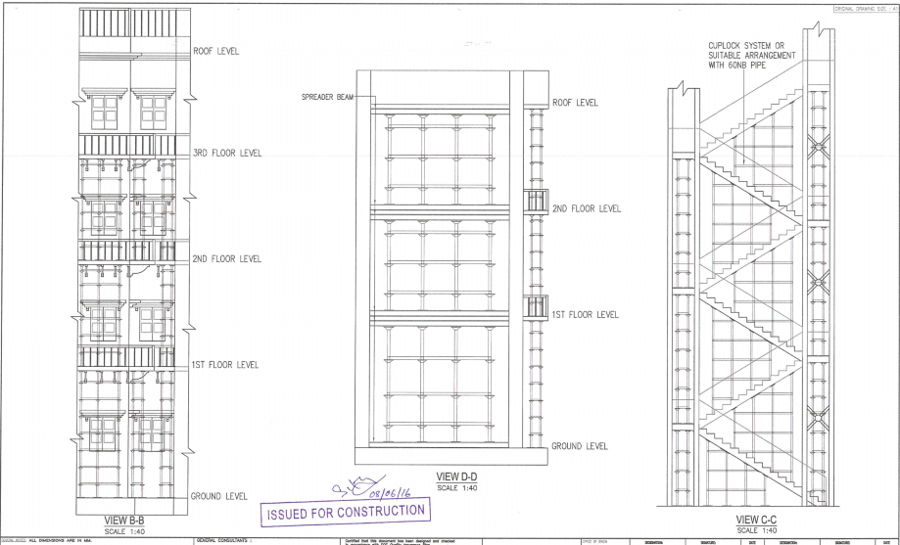
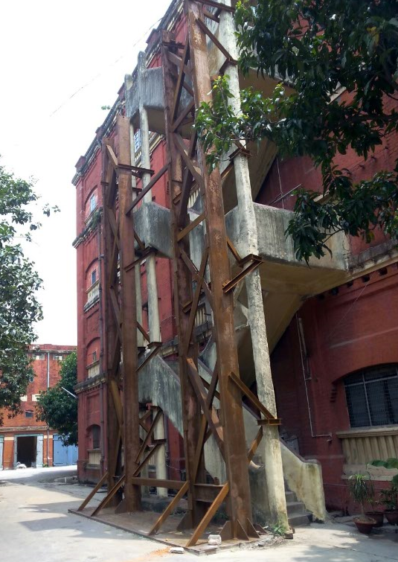
TUNNELING BELOW COLVIN COURT
Supporting System & Propping in Vulnerable Location
Slabs, arches, columns etc. supported using staging (such as cup lock system, use of tie rods, temporary or permanent propping, wrapping of columns etc.) within 25 m on either sides of bored tunnel.
Vertical propping at critical load transfer locations as an alternative load path. These supports should have jacking facility to ensure a positive support at all times.
Vulnerable location of staircase in South west corner as well as balcony at the back side were proposed to be supported and propped.
Challenges in Tunneling in East West Metro Kolkata

Slide 68
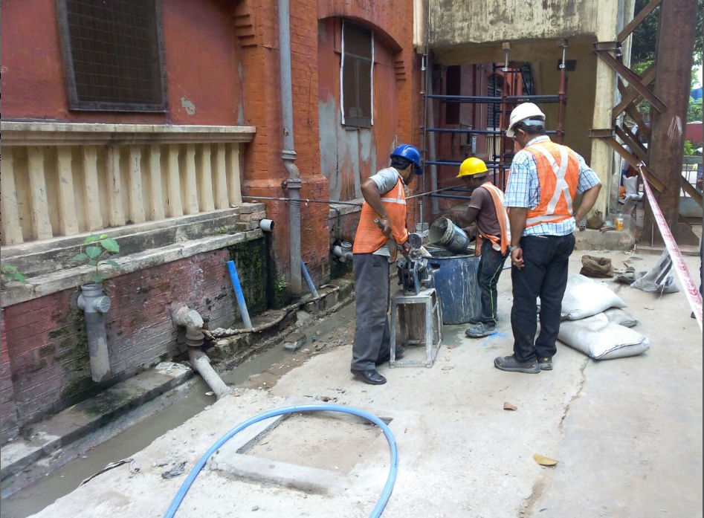
TUNNELING BELOW COLVIN COURT
Injection pressure grouting has been done with cementitious material through grout holes in ground level around the foundation @ 1m c/c during and after passage of tunnel. This grouting yielded considerable result as consumption of grout was considerably high.
Challenges in Tunneling in East West Metro Kolkata

Slide 69
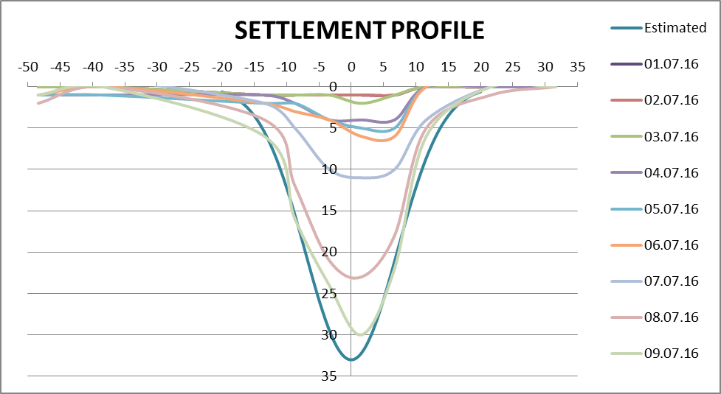
Challenges of Tunnelling in
East - West Metro Kolkata
Challenges in Tunneling in East West Metro Kolkata

Slide 70
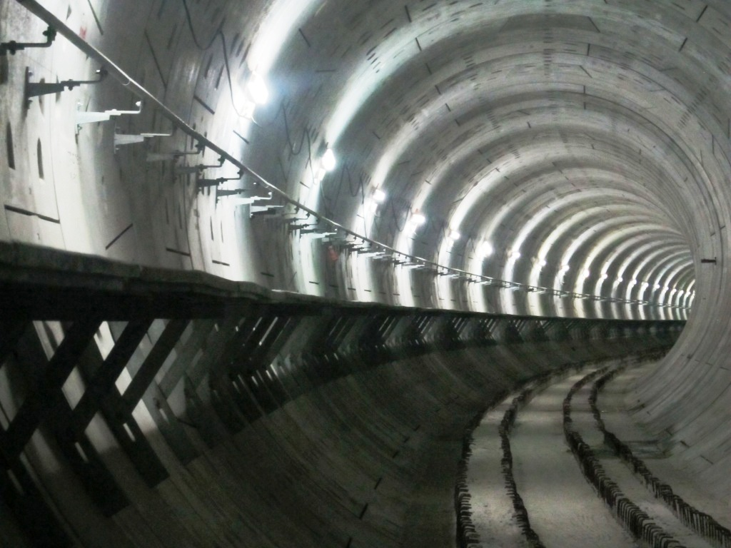
Completed Tunnel

Slide 71
CONCLUSION
Tunneling for East-West Metro Line faces technological challenges due to
conjested city with narrow Right Of Way.
Underground tunneling in soft clayey soil imposes considerable technical concerns.
Proper control of ground settlement and management of distress in buildings are demanded in such situations.
Proper coordination between TBM operation & monitoring of distress/settlement above ground is key to success
Challenges in Tunneling in East West Metro Kolkata

Slide 72
CONCLUSION
The tunnelling has been successfully done under the colvin court building .
All the shifted residents have been brought back after repairing the minor cracks .
This has motivated the Team/KMRCL to face the challenges ahead – crossing below the Bankim Setu , Howrah Yard & Platforms , office of DRM/HWH – more than 100 years old masonry building
and finally the mighty river Hooghly.
Challenges in Tunneling in East West Metro Kolkata

Slide 73
Thank You

Slide 74
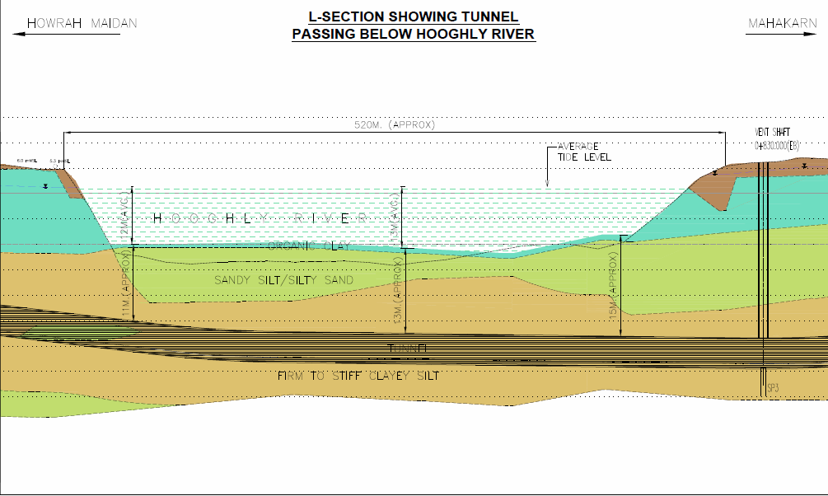
SCHEMATIC L-SECTION SHOWING TUNNEL PASSING UNDER RIVER HOOGHLY
Howrah Maidan
Mahakaran
520 m [ Approx]
Average Tide Level
12 m [ Avg]
Hooghly River
13 m [ Avg]
Organic Clay
33.24 m [ Approx]
18.7 m [Approx]
Sandy Silt/Silty Sand
19.5 m [ Approx]
16 m [ Approx]
Tunnel
Firm to Stiff Clayey Silt
Twin Tunnels having center to center distance of 16.1 m
Challenges in Tunneling in East West Metro Kolkata

